Slide 1
08-28 Computational Physics

Slide 2
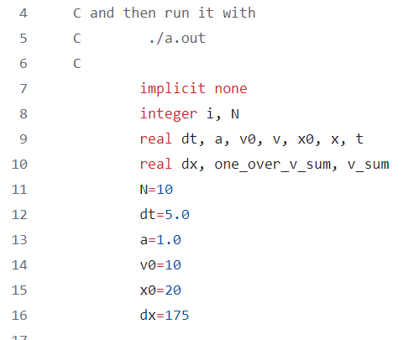
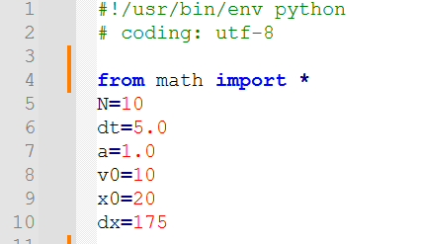
Fortran vs Python (bike ride speed example)

Slide 3
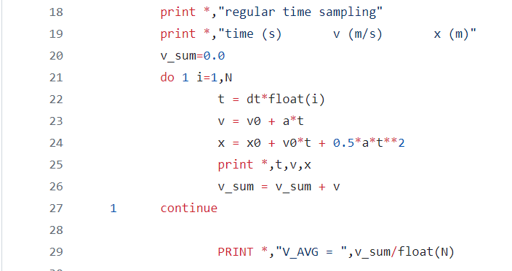
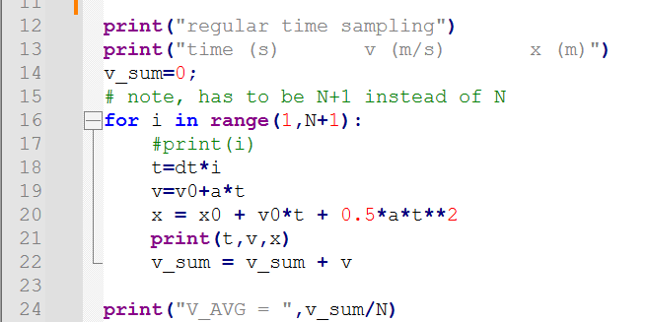
Fortran vs Python (bike ride speed example)

Slide 4
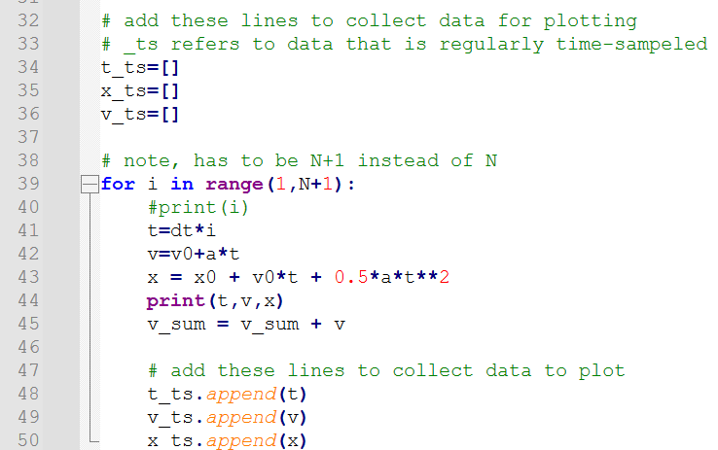
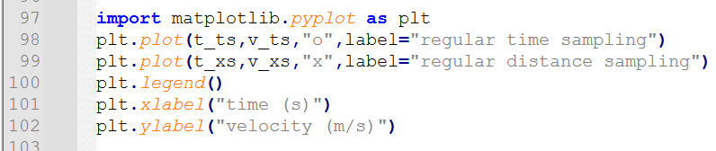
Speed example, what if I want to save points and plot? (Python makes this easier)

Slide 5
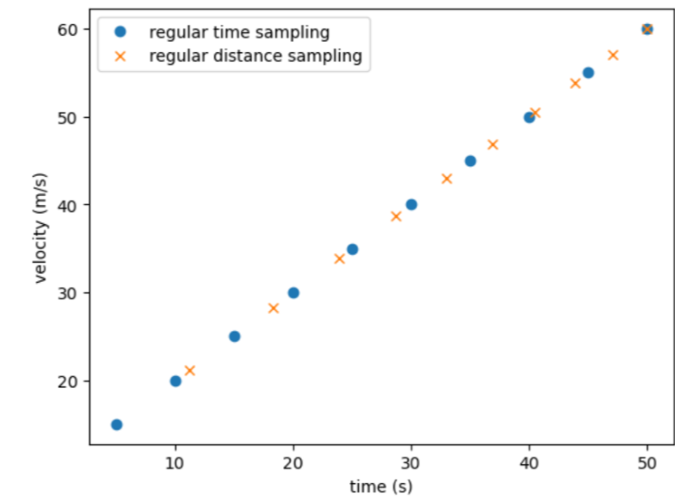
Python makes this easier possible, but slower+ more work in 1996 Fortran+linux

Slide 6
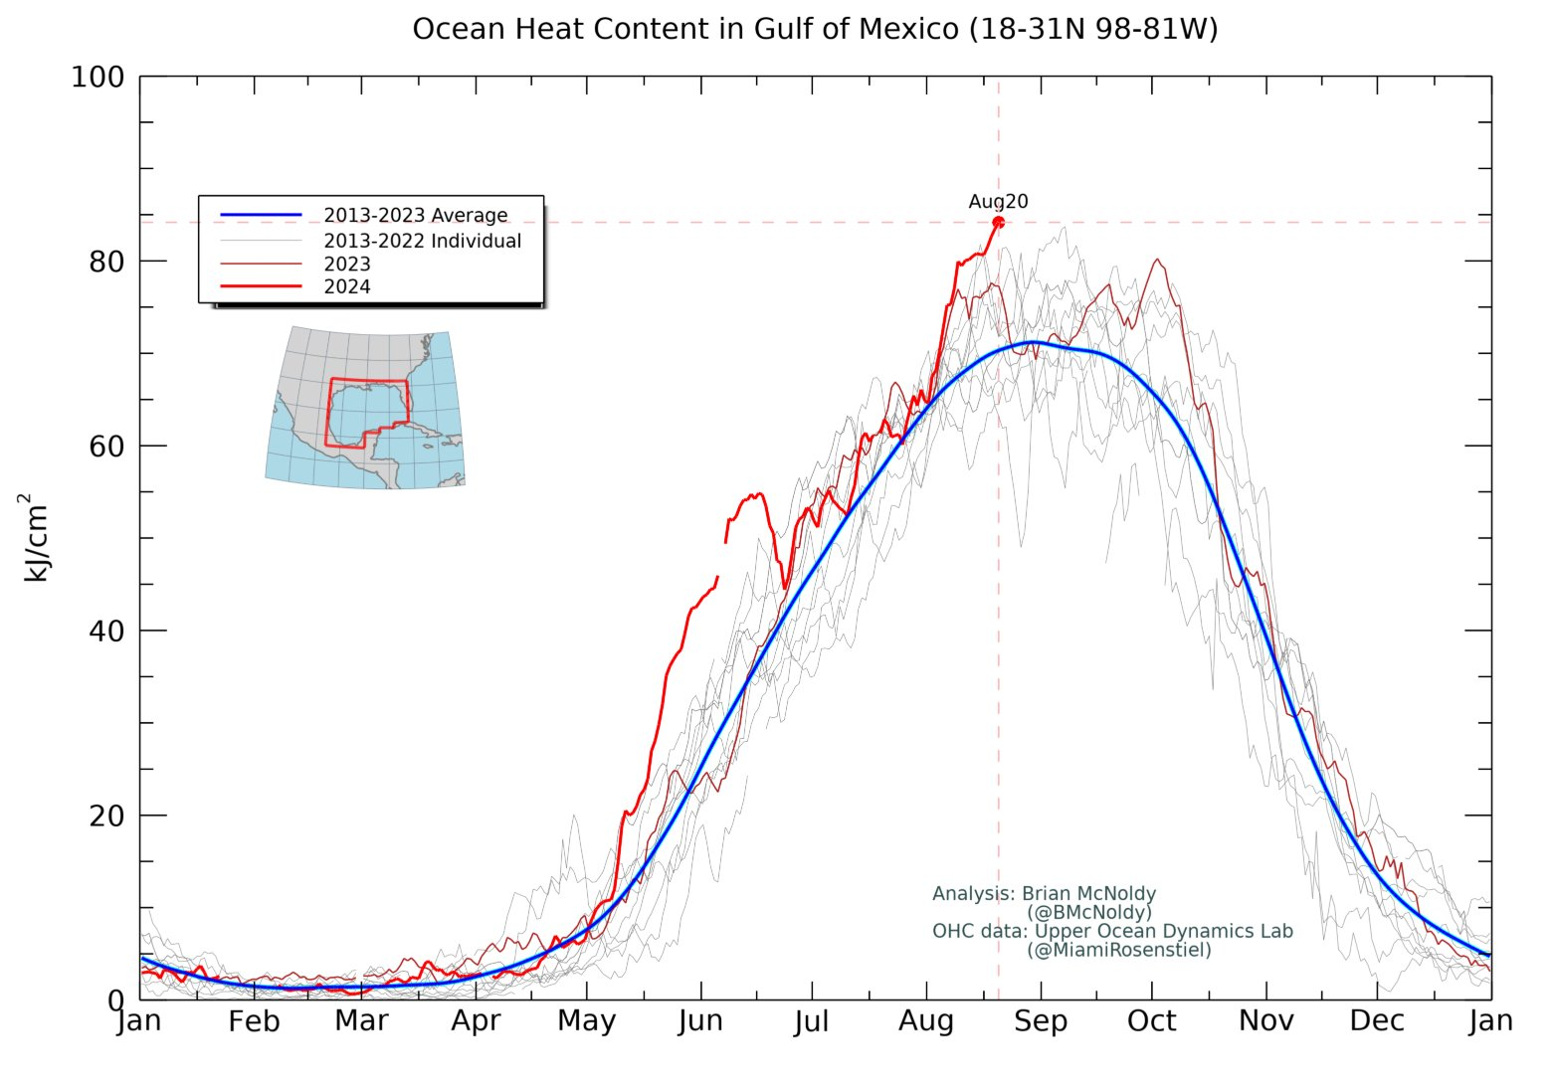
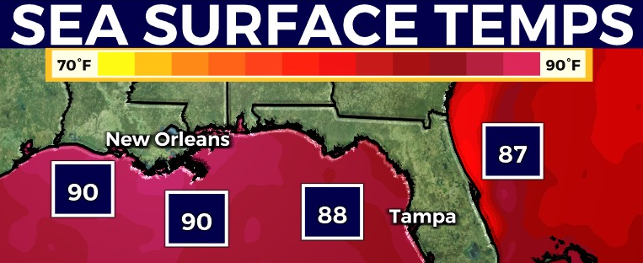
What will the weather be like tomorrow?
Notes:
Taylor series

Slide 7
What will the weather be like: 1. tomorrow? 2. in a week? 3. in a year?
Notes:
Taylor series

Slide 8
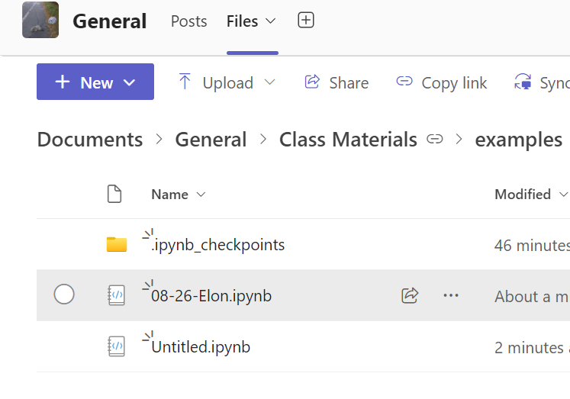
Here’s an example Python code

Slide 9

It takes about 24hours to coast to the Moon (Ranger 7 mission)
We could pay people to work out the trajectory in 1 second fidelity
$$x_{2}=x_{1}$$
$$x_{2}=x_{1}+v_{1}⋅dt$$
$$x_{2}=x_{1}+v_{1}⋅dt+\frac{1}{2}⋅a_{1}⋅dt^{2}$$
$$F_{g}=G\frac{M_{1}M_{2}}{r^{2}}$$

Slide 10
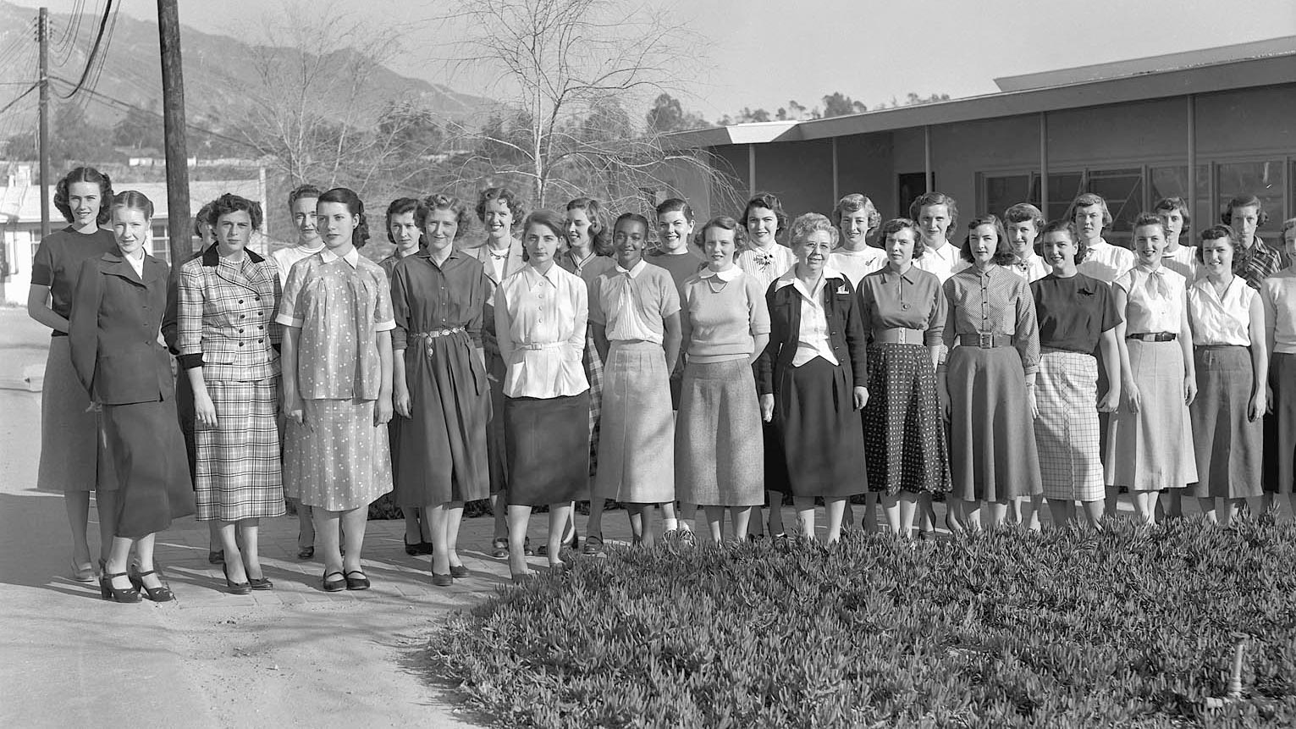
During the 1940s and 1950s, JPL used the word "computer" to refer to a person rather than a machine. The all-female computer team, many of the members recruited right out of high school, were responsible for doing all the math by hand required to plot satellite trajectories and more.
Notes:
https://en.wikipedia.org/wiki/Computer_%28occupation%29

Slide 11
Computational Physics:
Normally involves discrete numbers, not functions
Quality depends on the care of programmers (eg units, is dt small enough)
Isn’t “traditional” computer science (NTM MSFT recruiter string-copy story) but ironically, physics+math “invented” CS
Depends on documentation and clarity
Uses many languages (NTM has done “real” work in Excel, Python, Perl, C, C++, Fortran, Verilog, G-Labview, Matlab etc)

Slide 12
This isn’t a CS class – our focus is on Physics

